Slide 1
Programming Constructs in Databases

Slide 2
PL/SQL

Slide 3
INTRODUCTION
PL/SQL stands for procedural language/structured query language
It is an extension of the SQL language
It is the superset of structured query language
With the use of SQL user can only manipulate the information stored in the database
PL/SQL extends SQL by adding control structures found in other procedural languages.

Slide 4
Features of PL/SQL
PL/SQL allows sending an entire block of statements to the database at one time.
This reduces network traffic and provides high performance for the applications.
Applications written in PL/SQL are fully portable.
PL/SQL provides access to predefined SQL packages.
PL/SQL provides support for Object-Oriented Programming.
PL/SQL provides support for Developing Web Applications and Server Pages.

Slide 5
PL/SQL Architecture
Pl/sql engine executes pl/sql blocks.
Pl/sql engine executes only the procedural statements and send the sql statements to sql statement executor in the oracle server
Pl/sql engine resides in the oracle server
The call to the oracle engine needs to be made only once to execute any number of sql statements
Since the oracle engine is called only one for each block, resulting increased speed of processing as compared to call for each sql sentence.

Slide 6
Contd…
This technology is like an engine that exhibits PL/SQL blocks, subprograms like functions and procedures.
This engine can be installed in an Oracle Server or in application development tools such as Oracle Form Builder, Oracle Reports Builder etc.
These two environments are independent of each other. In either environment, the PL/SQL engine accepts any valid PL/SQL block as input.
The PL/SQL engine executes the procedural part of the statements and sends the SQL statement executer in the Oracle Server.
PL/SQL code can also be stored in the Oracle server as subprograms that can be referenced by any number of applications connected to the database.

Slide 7
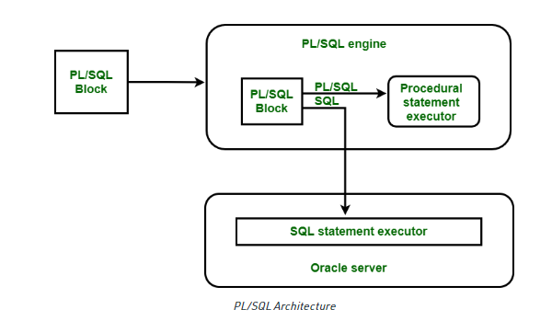

Slide 8
PL/SQL can reside in two environments
1. The Oracle Server
2. The Oracle tools

Slide 9
Structure of PL/SQL Language
Consist of following sections
Declare(optional)
Used to declare variables and constants
Is an optional section
Begin(required)
It is the executable section containing the code which is executed when block is run
Exception(optional)
Handles exceptions occurring during processing
Is an optional section.
End;(required)

Slide 10
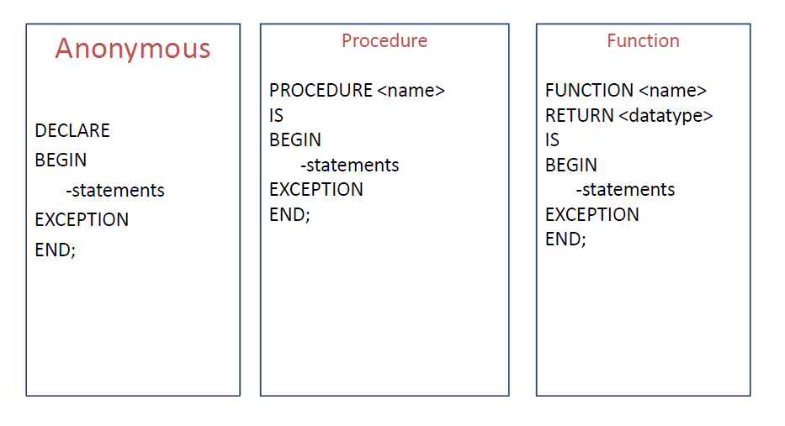
PL/SQL block types

Slide 11
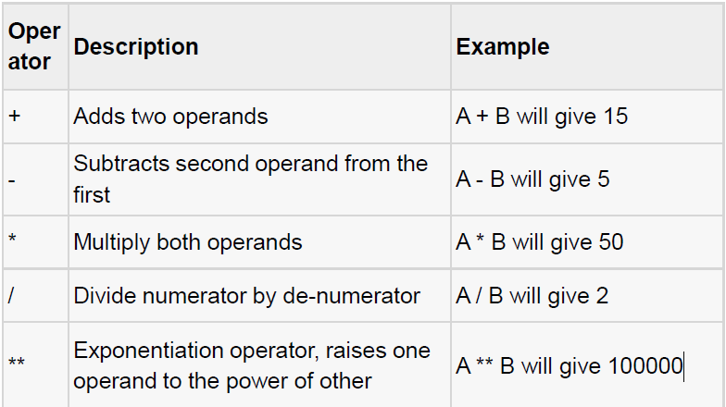
PL/SQL operators

Slide 12
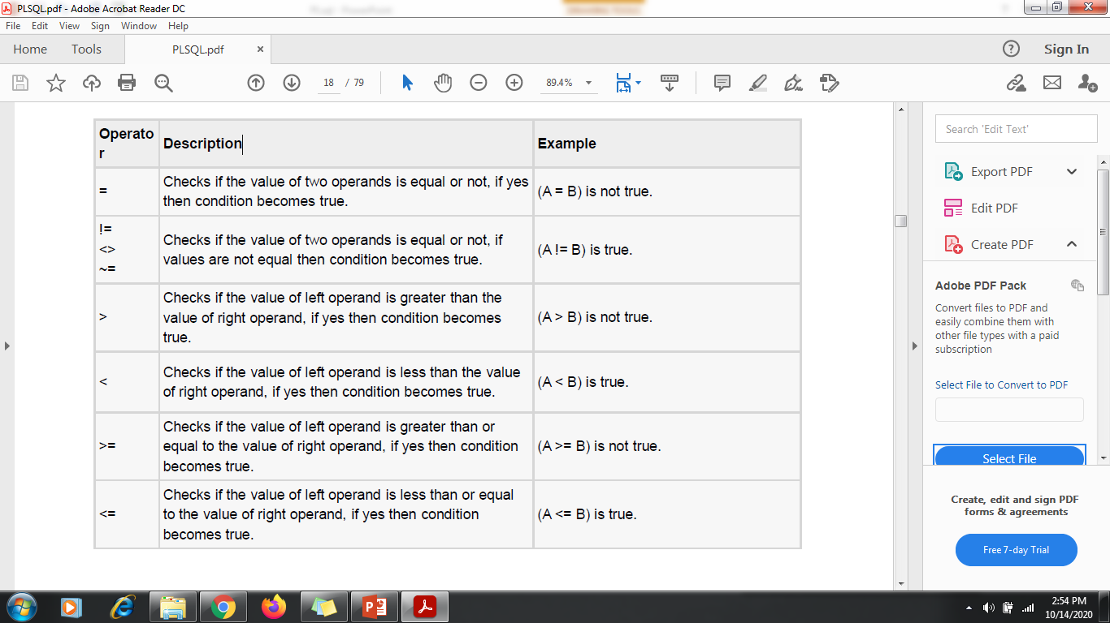
Relational operators

Slide 13
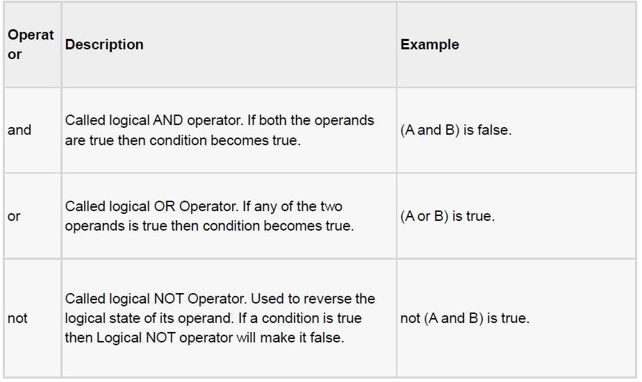
Logical operators

Slide 14
Variable Declaration
DECLARE
a number := 10;
b number := 20;
c number;
Declaring a Constant
PI CONSTANT NUMBER := 3.141592654;

Slide 15
Program to Print Hello World!

Slide 16
Example Program
DECLARE
message varchar2(20):= 'Hello, World!';
BEGIN
dbms_output.put_line(message);
END;

Slide 17
Read a value during runtime
Num:= :num;
This will produce a message on screen
Enter the value of NUM:
User can enter any value at run time to NUM.

Slide 18
Program to add any two numbers (Runtime)

Slide 19
Example- Program to add any two numbers
Declare
a number;
b number;
c number;
Begin
a:= :a;
b:= :b;
c:= a+b;
dbms_output.put_line('sum=' || c);
End;

Slide 20
Program to add two given numbers where a=20 and b=30
Declare
a number;
b number;
c number;
Begin
a:= 20;
b:= 30;
c:= a+b;
dbms_output.put_line('sum=' || c);
End;

Slide 21
Write one Program to perform following operations:
Addition
Division
Exponential
Multiplication
Subtraction

Slide 22
declare
a int;
b int;
c int;
d int;
e int;
p int;
s int;
begin
a:=:a;
b:=:b;
c:=a+b;
d:=a/b;
e:=a**b;
p:=a*b;
s:=a-b;
dbms_output.put_line(c);
dbms_output.put_line(d);
dbms_output.put_line(e);
dbms_output.put_line(p);
dbms_output.put_line(s);
end;

Slide 23
Select into
Used to fetch values from some existing tables.
Syntax-
Select column_name into variable_name from table_name where condition;

Slide 24
Example: Write a program to use Select into statement
declare
name varchar(10);
begin
select employeefirstname into name from employee where employeeid=1;
dbms_output.put_line(name);
end;

Slide 25
Program to Print Employeeid from Employee table where employee first name is John
declare
id int;
begin
select employeeid into id from employee where employeefirstname='John';
dbms_output.put_line(id);
end;

Slide 26
Control statements
Conditional / selection
Iterative
Sequence

Slide 27
Conditional / selection
IF condition then
Sequence of statements;
Else
Sequence of statements;
End if;

Slide 28
Write a Program to find greater number.

Slide 29
Example:
Declare
Num1 int;
Num2 int;
Begin
Num1:= :num1;
Num2:= :num2;
If num1>num2 then
dbms_output.put_line('greater number is:=' || num1);
Else
dbms_output.put_line('greater number is:=' || num2);
End if;
End;

Slide 30
Write a Program to find SMALLEST number.

Slide 31
Iterative
Loop
While – loop
For-loop

Slide 32
Loop
Sequence of statements;
Exit when condition;
End loop;

Slide 33
Write a program to print 1 to 10 using LOOP

Slide 34
Loop Example- Program to print 1 to 10 using LOOP
Declare
i number(2);
Begin
i:=1;
Loop
Dbms_output.put_line(i);
i:=i+1;
Exit when i>10;
End loop;
End;

Slide 35
While loop
(Program To find square of a number)

Slide 36
While Loop Example- (Program To find square of a number)
Declare
A number(20);
Begin
A:=1;
While a<=10
Loop
Dbms_output.put_line(a*a);
A:=a+1;
End loop;
End;

Slide 37
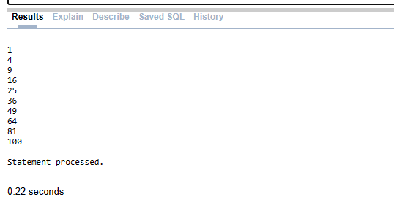
Output:-

Slide 38
For Loop
Program to print 1 to 10 using For Loop

Slide 39
Program to print 1 to 10
declare
a number;
begin
for a in 0..10
loop
dbms_output.put_line('value of a:'||a);
end loop;
end;

Slide 40
FOR Loop
Program to generate Multiplication Table for 2.

Slide 41
For loop Example- Program to generate Multiplication Table for 2 using For Loop.
Declare
Total number(4);
Begin
For i in 1..10
Loop
Total:=2*i;
Dbms_output.put_line('2*'||i||'='||total);
End loop;
End;

Slide 42
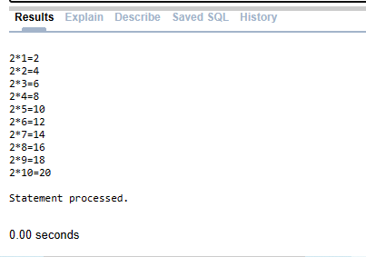
Output:-

Slide 43
Program to generate Multiplication Table for any number at run time using For Loop

Slide 44
declare
a int;
begin
a:=:a;
for i in 0..10
loop
dbms_output.put_line(a||'*'||i||'='||a*i);
end loop;
end;

Slide 45
Program to find even and odd numbers
-Using If else

Slide 46
1ST Way:
DECLARE
n int;
r int;
BEGIN
n:=:n;
r := MOD(n, 2);
IF r = 0 THEN
dbms_output.Put_line('Even');
ELSE
dbms_output.Put_line('Odd');
END IF;
END;

Slide 47
2nd Way:
DECLARE
n NUMBER := :n;
r NUMBER;
BEGIN
r := MOD(n, 2);
IF r = 0 THEN
dbms_output.Put_line('Even');
ELSE
dbms_output.Put_line('Odd');
END IF;
END;

Slide 48
PL/SQL Go To statement
The GOTO statement allows you to transfer control to a labeled block or statement. The following illustrates
Syntax of the GOTO statement:
GOTO label_name;
Here the label declaration which contains the label_name encapsulated within the << >> symbol and must be followed by at least one statement to execute.
E.g.
GOTO label_name;
..
..
<<label_name>>
Statement;

Slide 49
Program to find greater number using Goto statement

Slide 50
Go To Example-1
Declare
Num1 number;
Num2 number;
Begin
Num1:=:num1;
Num2:=:num2;
If num1> num2 then
Goto p1;
Else
Goto p2;
End if;
<<p1>>
Dbms_output.put_line('num1 is bigger');
Goto p3;
<<p2>>
Dbms_output.put_line('num2 is bigger');
<<p3>>
Dbms_output.put_line('End of Program');
End;

Slide 51
Declare
num1 number;
num2 number;
Begin
num1 := :num1;
num2 := :num2;
if num1>num2 then
Goto p1;
elsif num1<num2 then
Goto p2;
else
Goto p3;
end if;
<<p1>>
dbms_output.put_line('first number is greater');
Goto p4;
<<p2>>
dbms_output.put_line('second number is greater');
Goto p4;
<<p3>>
dbms_output.put_line('Numbers are equal');
<<p4>>
null;
end;

Slide 52
Program to find greater number among three numbers using Goto statement

Slide 53
Declare
a int;
b int;
c int;
begin
a:=:a;
b:=:b;
c:=:c;
if a>b and a>c then
goto p1;
elsif b>c then
goto p2;
else
goto p3;
end if;
<<p1>>
dbms_output.put_line('greater number is='||a);
goto p4;
<<p2>>
dbms_output.put_line('greater number is='||b);
goto p4;
<<p3>>
dbms_output.put_line('greater number is='||c);
<<p4>>
dbms_output.put_line('End of program');
end;

Slide 54
Subprograms
A PL/SQL subprogram is a named PL/SQL block that can accept parameters and can be invoked repeatedly.
Two types:
Procedure
Function
Stored procedure: a procedure that has been compiled and stored in any of the oracle engine’s system table.

Slide 55
Procedure Vs Function
A procedure or a function is a group of SQL and PL/SQL statements that is used to perform a specific task.
A procedure is used to perform an action whereas a function is used to compute a value.
A procedure may return no value whereas a function must return a value.

Slide 56
Why do we use subprograms?
Modularity: It allows a programmer to divide a program into more than one well defined units called modules.
Reusability: it enables a subprogram to be used in any number of applications.

Slide 57
Procedure
Declare
Global variables declaration;
Procedure procedure name
(Arguments IN/OUT/IN OUT data types)
IS/AS
Variable and constant declaration;
Begin
PL/SQL statements;
Exception
Statements;
End procedure name;
Begin
Executable statements;
Procedure calling;
End;

Slide 58
Procedure- example Write a program to find multiplication of two numbers using Procedures.
declare
num1 number(2);
num2 number(2);
mul number(4);
procedure multiplication (num1 in number, num2 in number, mul out number)is
begin
mul:=num1*num2;
end multiplication;
begin
num1:=:num1;
num2:=:num2;
multiplication(num1, num2, mul);
dbms_output.put_line(mul);
end;

Slide 59
Functions
The PL/SQL Function is very similar to PL/SQL Procedure.
The main difference between procedure and a function is, a function must always return a value, and on the other hand a procedure may or may not return a value.

Slide 60
Function
Declare
Global variables declaration;
Function Function name
(Arguments IN data types…….)
Return data type
IS/AS
Variable and constant declaration;
Begin
PL/SQL statements;
Exception
Statements;
End function name;
Begin
Executable statements;
Function calling;
End;

Slide 61
Write a program to find multiplication of two numbers using Functions.

Slide 62
Function-Example Write a program to find multiplication of two numbers using Functions.
Declare
Num1 number(2);
Num2 number(2);
Mul number(4);
Function multiplication(num1 in number, num2 in number)
Return number is mul number;
Begin
Mul:=num1 * num2;
Return(mul);
End multiplication;
Begin
Num1:=:num1;
Num2:=num2;
Mul:=multiplication(num1, num2);
Dbms_output.put_line(mul);
End;

Slide 63
Write a program to find Factorial of two numbers using Functions.

Slide 64
Function-Example Write a program to find Factorial of two numbers using Functions.
Declare
Fact int;
N int;
Function factorial(n in number)
Return number is I number(2);
Begin
Fact:=1;
For I in 1..n loop
Fact:=fact*I;
End loop;
Return(fact);
End factorial;
Begin
N:=:n;
Fact:=factorial(n);
Dbms_output.put_line(fact);
End;

Slide 65
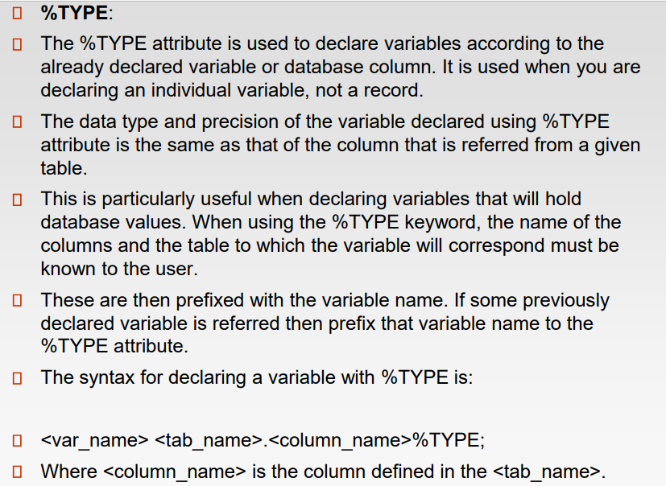
% TYPE

Slide 66
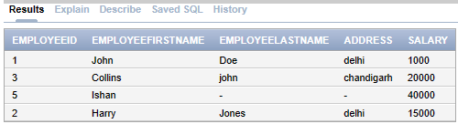
select * from employee;

Slide 67
DECLARE
sal employee.salary% TYPE;
BEGIN
Select salary into sal from employee where employeeid = 1;
dbms_output.put_line('Salary of employee with employeeid=1 is :'|| sal);
END;

Slide 68
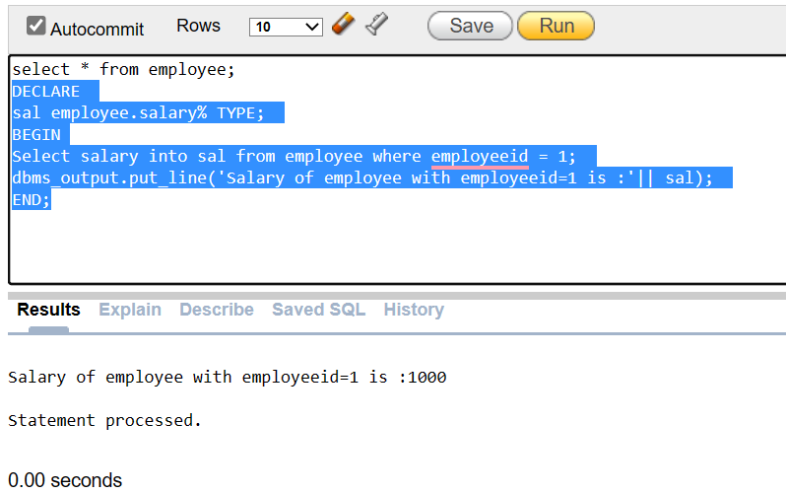

Slide 69
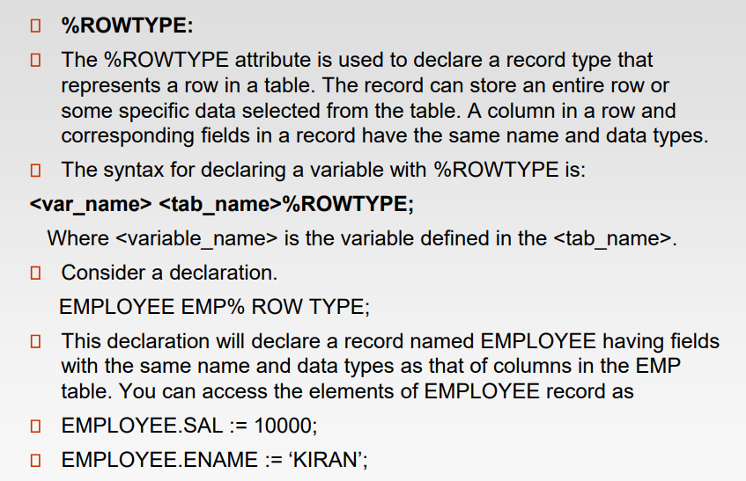
%ROWTYPE

Slide 70
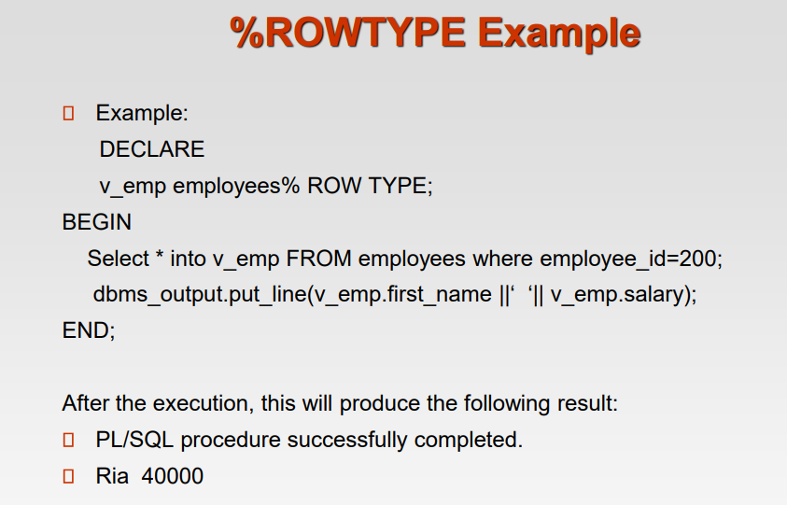

Slide 71
Example:-
DECLARE
emp1 employee% ROWTYPE;
BEGIN
Select * into emp1 FROM employee where employeeid=1;
dbms_output.put_line(emp1.employeefirstname||' '||emp1.salary);
END;

Slide 72
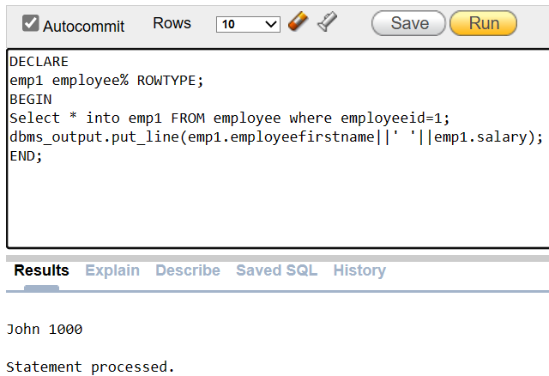

Slide 73
Exception Handling

Slide 74
Write a program in PL/SQL for Exception:- more than one row returned (use %type )

Slide 75
Exception handling- example
create table empp(id int, name varchar(10));
insert into empp values(502, 'a');
insert into empp values(502, 'a');
insert into empp values(502, 'a');
declare
n empp.name% type;
begin
select name into n from empp where id=502;
dbms_output.put_line('empname :='||n);
exception
when too_many_rows then
dbms_output.put_line('more than one row returned');
end;

Slide 76
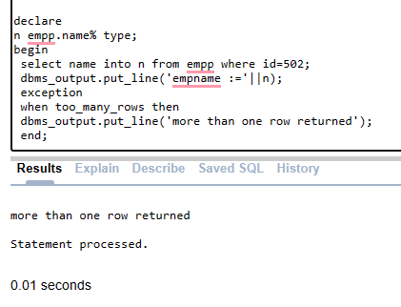
Example:

Slide 77
Write a Program for Exception handling (Error:-divide by Zero)

Slide 78
Exception handling- example
declare
a number;
b number;
c number;
e exception;
begin
a:=:a;
b:=:b;
if b=0 then
raise e;
end if;
c:=a/b;
dbms_output.put_line('result='||c);
exception when e then
dbms_output.put_line('error!- your divisor is zero');
end;

Slide 79
Stored Procedures
A stored procedure is a set of Structured Query Language (SQL) statements with an assigned name, which are stored in a relational database management system (RDBMS) as a group, so it can be reused and shared by multiple programs.

Slide 80
STORED PROCEDURES
create or replace procedure addition(num1 in number,num2 in number, sum1 out number)
is
begin
sum1:=num1+num2;
end;
declare
num1 number(2);
num2 number(2);
sum1 number(2);
begin
num1:= :num1;
num2:= :num2;
addition(num1,num2,sum1);
dbms_output.put_line('SUM= '||sum1);
end;

Slide 81
Cursors

Slide 82
Cursors
A cursor is a work area where the result of a SQL query is stored at server side.
The contents of a cursor are then displayed at client machine via a network.
Known as active data set
– Declare a cursor
– Open a cursor
– Read from a cursor
– Close cursor

Slide 83
Types of cursors
Implicit cursor
Work area that is declared, opened and closed internally by oracle engine.
Explicit cursor ( user defined)
Define in DECLARE section of PL/SQL block

Slide 84
Cursor attributes
%ISOPEN
%FOUND
%NOTFOUND
%ROWCOUNT

Slide 85
Implicit cursors
SQL%ISOPEN
SQL%FOUND
SQL%NOTFOUND
SQL%ROWCOUNT

Slide 86
Steps of execution
Declare the cursor
Open the cursor
Using loop, fetch the data from cursor one row at a time and store in memory variable
Exit from the loop
Close the cursor

Slide 87
Cursors Program:
Declare
Cursor C1 Is Select employeeid,salary from employee where employeelastname='Doe';
my_id employee.employeeid%Type;
my_sal employee.salary%Type;
Begin
Open C1;
LOOP
Fetch C1 into my_id,my_sal;
Exit When C1%Notfound;
Update employee set salary=salary+1000 where employeeid=my_id;
END LOOP;
Close C1;
End;

Slide 88
Triggers
Stored procedures that automatically executed when some event occurs to data base.
Events are
Insert
Delete
Update

Slide 89
Trigger vs procedures
Triggers do not accept parameters.
Triggers are executed automatically without user calling.

Slide 90
Parts of trigger
Triggering event or statement
Trigger restriction
Is boolean value true or false.
Trigger action

Slide 91
Types of triggers
Row trigger
Fired for each row effected by trigger statement.
Statement trigger
Fired once for triggering statements regardless of number of rows effected.

Slide 92
BEFORE trigger
Trigger executes its trigger action before the triggering statement
AFTER trigger
Trigger executes its trigger action after the triggering statement

Slide 93
Use Triggers
Create or replace trigger t11
BEFORE DELETE On Main
For each row
Begin
Insert into Backup values (:old.id, :old.salary);
End;

Slide 94
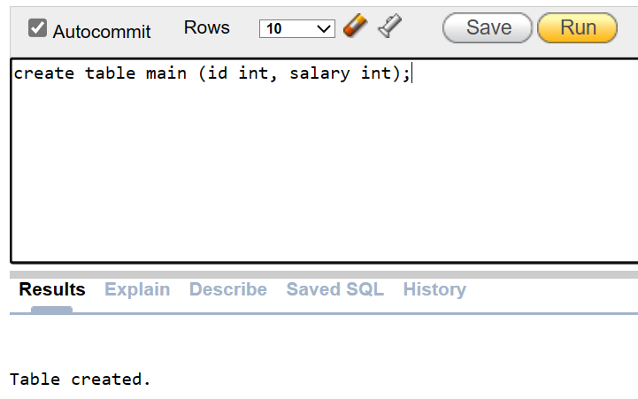

Slide 95
create table main (id int, salary int);
insert into main values(1, 10000);
insert into main values(2, 20000);
create table backup (id int, salary int);
(No need to enter anything manually in backup table)

Slide 96
Create or replace trigger t1
BEFORE DELETE On Main
For each row
Begin
Insert into Backup values (:old.id, :old.salary);
End;

Slide 97
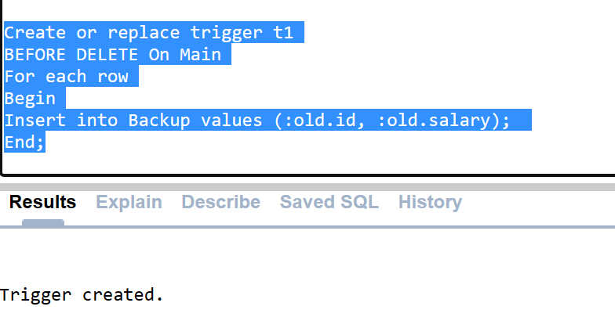

Slide 98
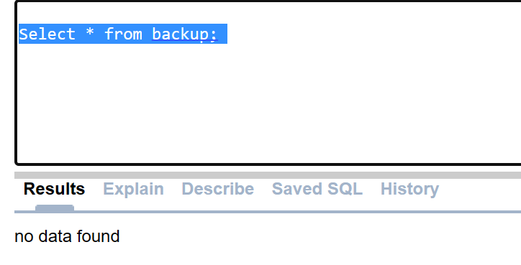
Select * from backup;
We have just created Trigger. Triggered will be fired only after deletion from Main table. Therefore, Backup table is empty at this moment.

Slide 99
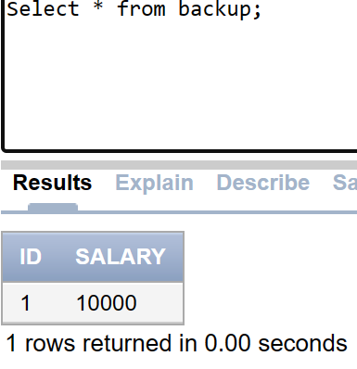
Contd..
Now, delete the row from main table.
delete from main where id=1;
Now check Main table after deletion of a row:
Select * from main;

Slide 100
Now check, whether that data is in back up table when we deleted it from the main table. (as Trigger will work on the Backup table, when we delete it from the Main table, it will be stored in the Back up table)
Select * from backup;

Slide 101
Contd…
This row was deleted from the Main table.
Data was inserted automatically in to Back up table whenever data is deleted from the Main table.

